Slide 1
REAL ESTATE
MARKET ANALYSIS
Welcome to our insights on Egypt's real estate market.

Slide 2
TABLE OF CONTENTS
01
02
03
TEAM MEMBERS
INTRODUCTION
GOAL OF THE PROJECT
04
05
06
CLEANING PHASE
DYNAMIC DASHBOARD
ANALYSIS PHASE
07
CONCLUSION

Slide 3
TEAM MEMBERS
01
02
Haneen Hossam
Hadeel Ayman
03
04
Mohamed Hakam
Ahmed Elkomy
CONTENT TABLE

Slide 4
INTRODUCTION
CONTENT TABLE
Egypt
REAL ESTATE

Slide 5
What Is This Presentation About?
PROPERTY TYPES
A MARKET ADAPTED TO YOUR NEEDS
LOCATION CHOICES
CONTENT TABLE
Property choices range from city apartments to suburban villas, with prices influenced by location, type, and amenities.
Egypt’s real estate market offers diverse options, from residential compounds to various city regions, shaped by growing demand and buyer preferences.
Buyers can choose between urban convenience or quieter suburban spaces, each offering unique advantages.

Slide 6
The Analysis of The Project
CONTENT TABLE
WHAT WE ANALYZED :
In this project, we analyzed key aspects of the real estate market, including property prices, locations, and delivery timelines.
INSIGHTS ON PROPERTY FEATURES :
We also examined property features such as the number of bedrooms, bathrooms, and the overall area size, providing detailed insights into buyer preferences.
MARKET TRENDS & FORECAST :
Our analysis offers valuable insights into current market trends and helps forecast future developments in Egypt’s real estate landscape.

Slide 7
Data Source
CONTENT TABLE
WE SEARCHED IN MULTIPLE DATA SITES
1. Data World
UCI .4
2. Kaggle
Github Datasets .5
3. HumData
Knoema .6
We finally found the suitable dataset for our topic on Kaggle.

Slide 8
GOAL OF THE PROJECT
CONTENT TABLE
Egypt
REAL ESTATE

Slide 9
What Do We Aim To?
CONTENT TABLE
The goal of our project is to analyze the real estate market in Egypt using detailed data. Through this analysis, we aim to identify trends and patterns in property prices, locations, and features, providing a clearer understanding of the market landscape and helping individuals make informed decisions about real estate opportunities.

Slide 10
CLEANING PHASE
CONTENT TABLE
Always Start with Cleaning!!
Egypt
REAL ESTATE

Slide 11
Excel & Power Query
CONTENT TABLE
We Wanted to have the region of every city. The Steps we Made in this slide was on excel. First step, we added a new sheet, and copied the city column into the new sheet. Second step, opened power query and in the new sheet we removed the duplicates of city column, then we closed & load to excel. Third step, in the data section we used Data Validation to write the regions we want to add, then select the column the region will be in it. Fourth and last step, choosing manually the region of every city.
You can see the steps in the next slides.

Slide 12
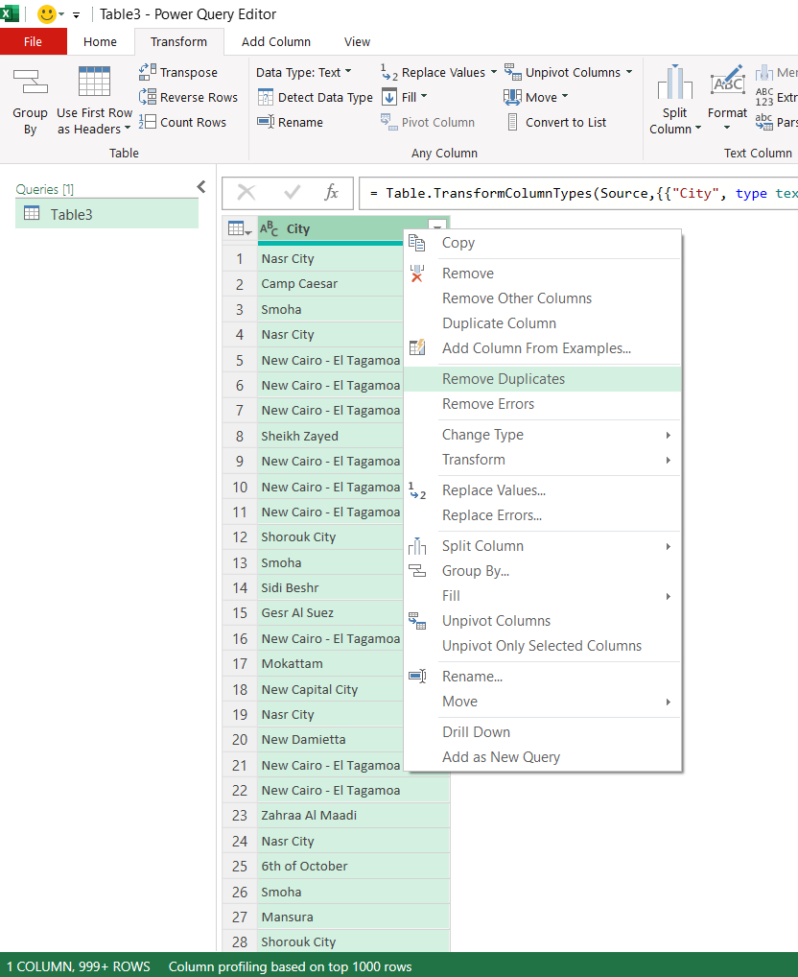
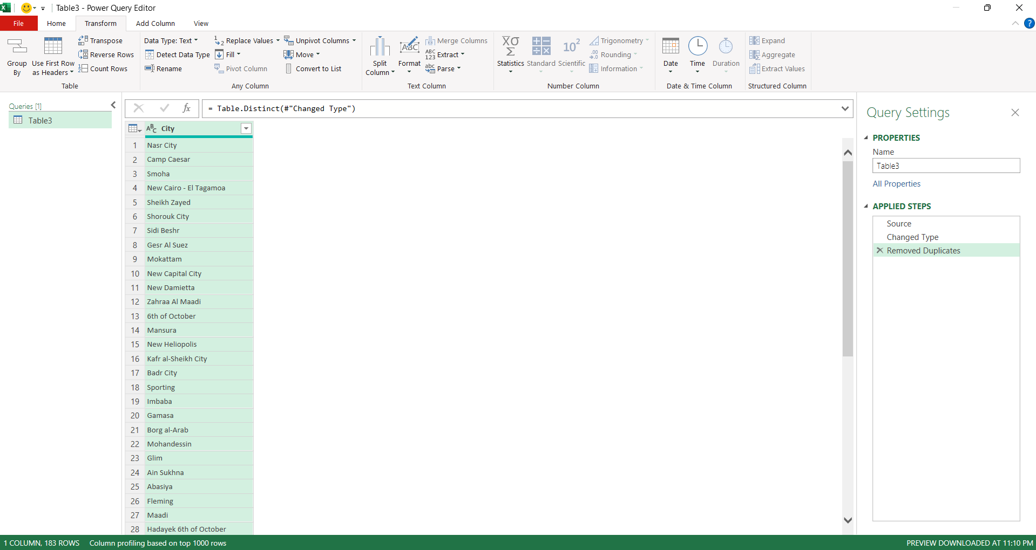
Excel & Power Query
CONTENT TABLE

Slide 13
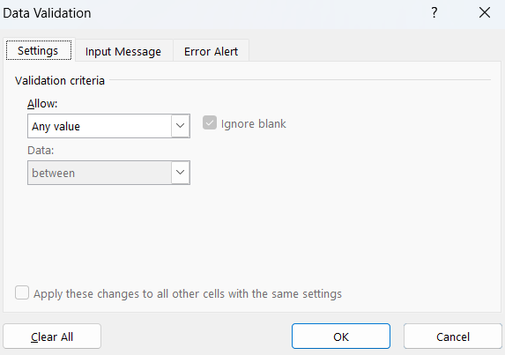
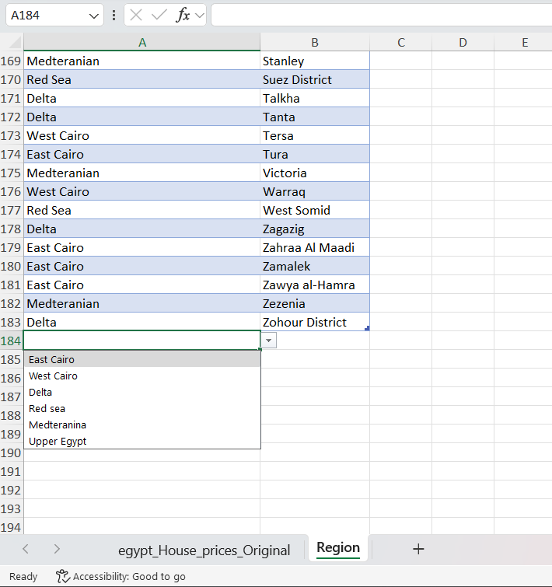
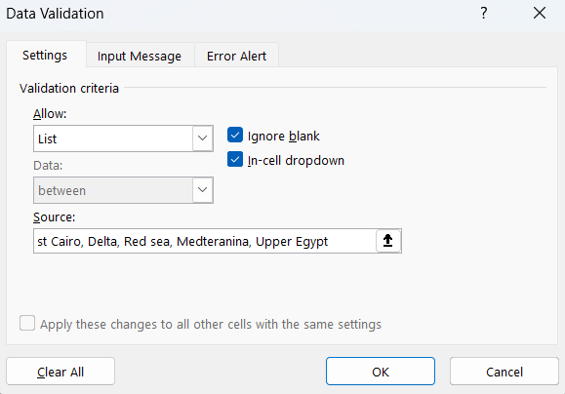
Excel & Power Query
CONTENT TABLE

Slide 14
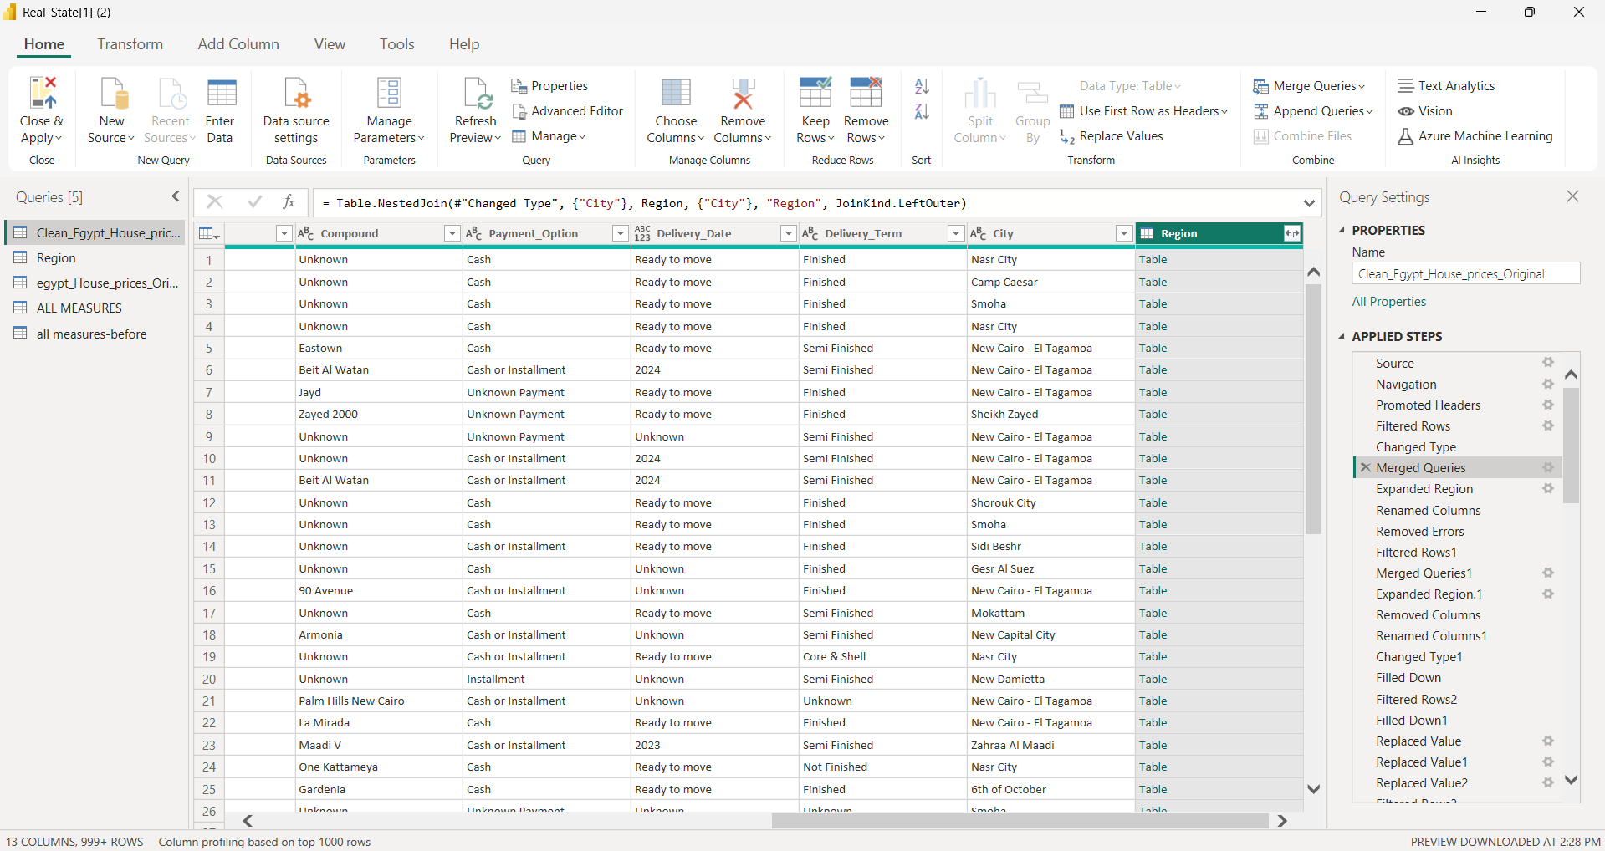
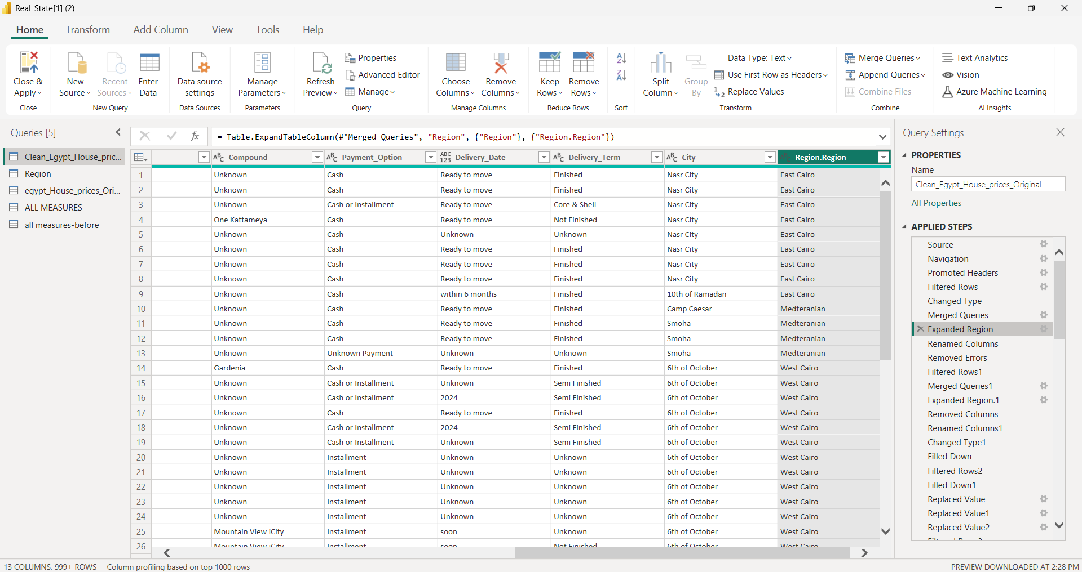
Power Query in Power BI
CONTENT TABLE
We Started with Transforming The Data to Power Query.
We Used Merge Query to Define The Region of Each City We Mentioned earlier.

Slide 15
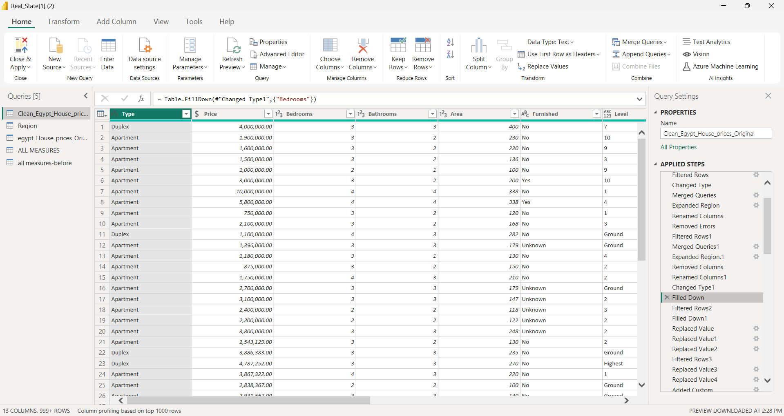
Power Query in Power BI
CONTENT TABLE
We Used The Fill Down Method to Fill The Blanks to Make The Data More Accurate.

Slide 16
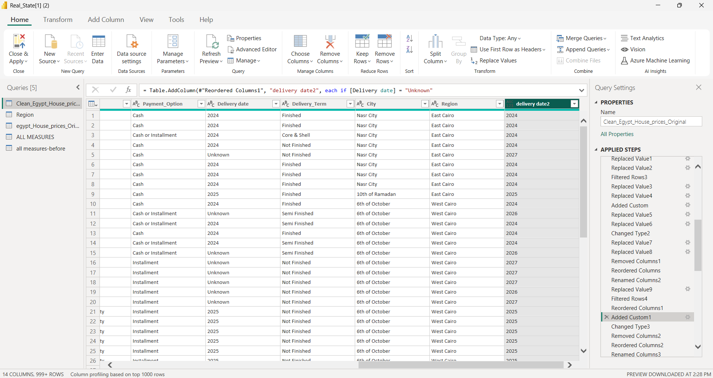
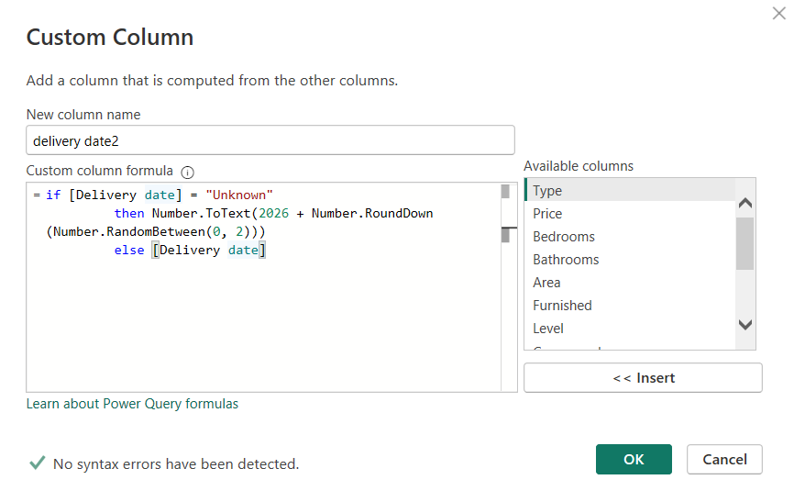
Power Query in Power BI
CONTENT TABLE
In The Delivery Date Column There was Row Are Unknown, We Solved it using Condition and Delivery Term Column, If The Delivery Term is Finished The Date Will be 2024, If Other The Year Will be from 2026 to 2027.

Slide 17
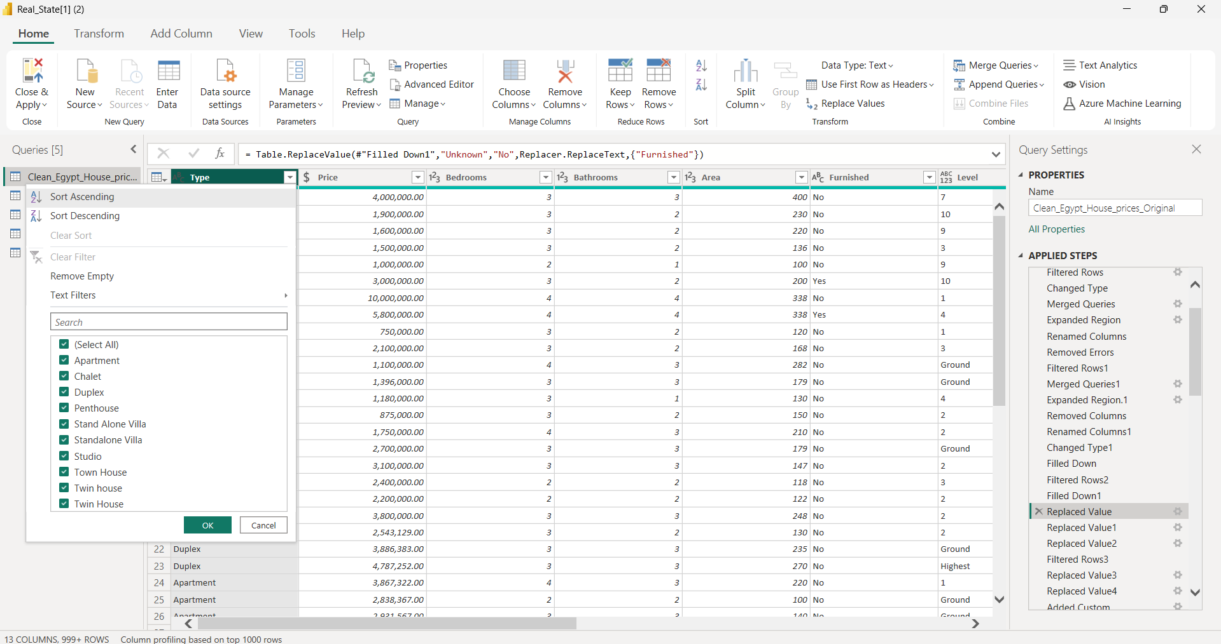
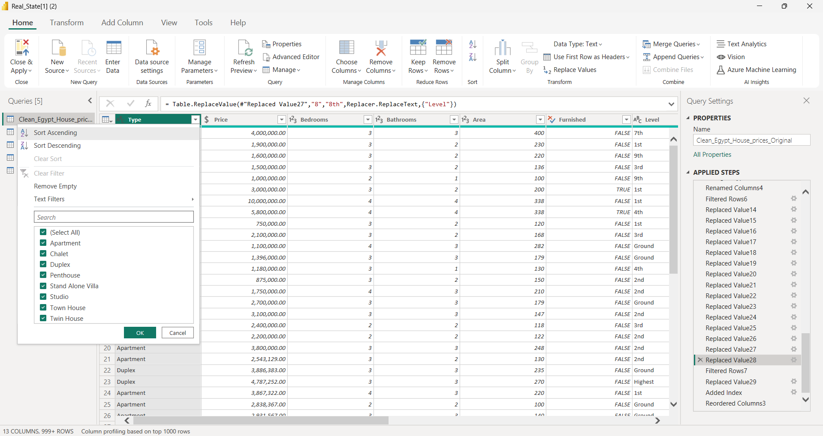
Power Query in Power BI
CONTENT TABLE
You Will Notice That There a lot of Replaced Values, We did it to Make The Data More Readable, Some Cells have Wrong Spelling and other not Clear.

Slide 18
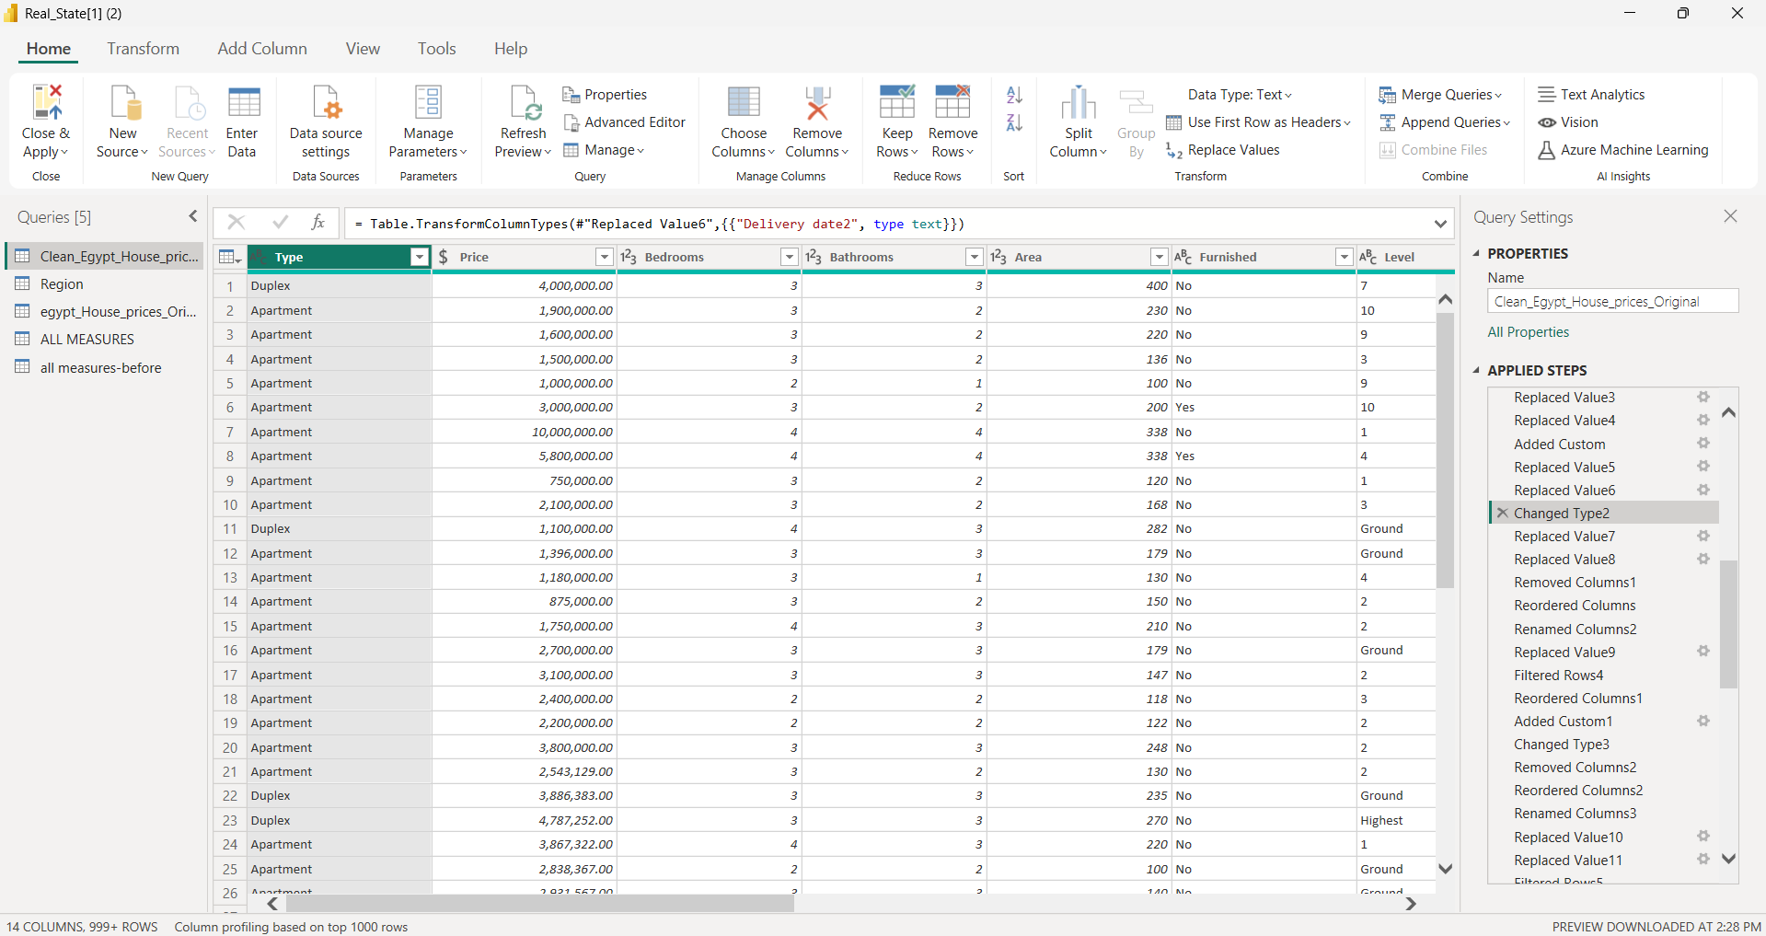
Power Query in Power BI
CONTENT TABLE
Change Type of Data to be More Accurate.

Slide 19
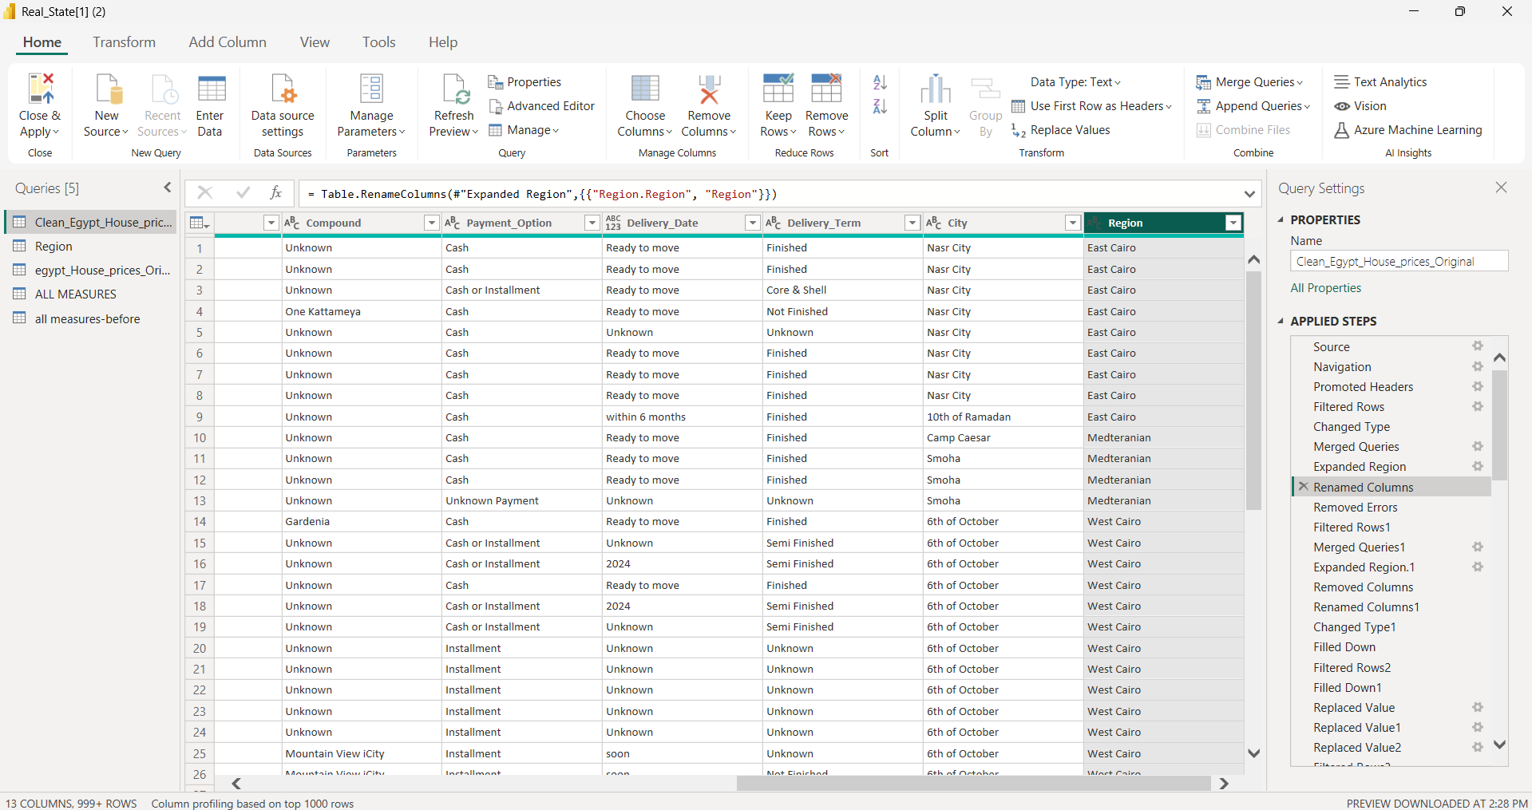
Power Query in Power BI
CONTENT TABLE
Renamed Column to be Understandable.

Slide 20
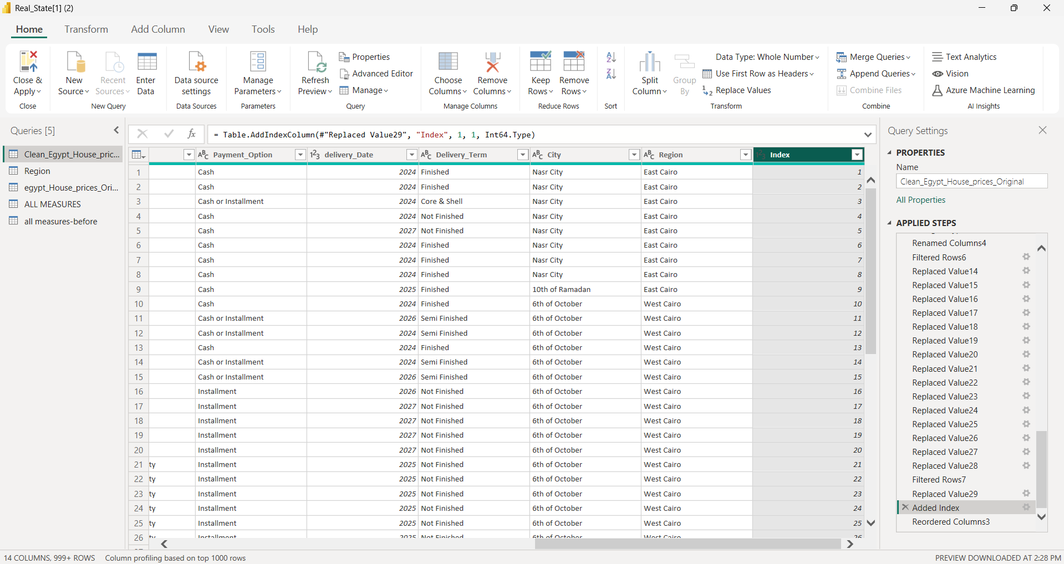
Power Query in Power BI
CONTENT TABLE
Added Index Column to Count The Offers.

Slide 21
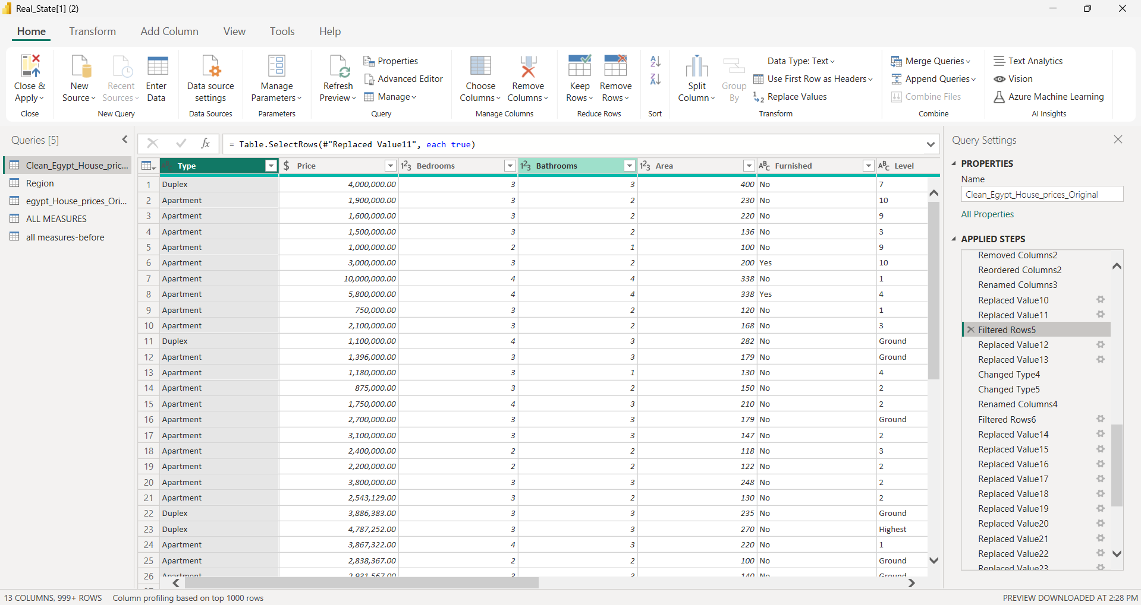
Power Query in Power BI
CONTENT TABLE
Filtered Some Rows That have Unknown Cells about 50-100, We Filtered The Cells to Make The Data Accurate.

Slide 22
DYNAMIC DASHBOARD
CONTENT TABLE
Egypt
REAL ESTATE

Slide 23

Real State Egypt
Microsoft Power BI

Slide 24
ANALYSIS PHASE
CONTENT TABLE
Charts Always Have a Story.
Egypt
REAL ESTATE

Slide 25
Summary Measures
CONTENT TABLE
This Measure Calculates The Average Area of Units.
This Measure Calculates The Average Price of Units.
These Measures Calculates The Maximum and Minimum Price of Units.

Slide 26
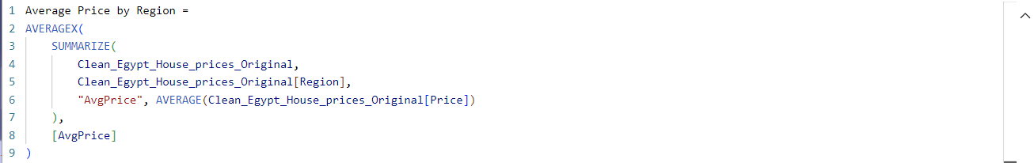
Summary Measures
CONTENT TABLE
These Measures Calculate The Number of Furnished and Unfurnished Units.
This Measure Calculates The Number of Units.
This Measure Calculates Average Price by Region (The Same Method Was Used with Compound and Payment Option).
Note: Other Measures Added.

Slide 27
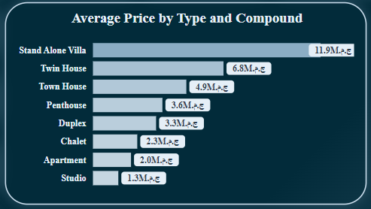
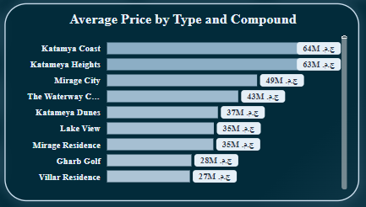
Key Insights of Price by Type and Compound
CONTENT TABLE
At 11,888,244 ج.م.‏, Stand Alone Villa had the highest Average of Price and was 796.83% higher than Studio, which had the lowest Average of Price at 1,325,581 ج.م.‏.
Across all 8 Type, Average of Price ranged from 1,325,581 ج.م.‏ to 11,888,244 ج.م.‏.
At 64,475,000 ج.م.‏, Katamya Coast had the highest Average of Price and was 92,007.14% higher than Fanar De Luna, which had the lowest Average of Price at 70,000 ج.م.‏.﻿﻿﻿﻿
﻿﻿Katamya Coast had the highest Average of Price at 64,475,000 ج.م.‏, followed by Katameya Heights and Mirage City. Fanar De Luna had the lowest Average of Price at 70,000 ج.م.‏.﻿﻿
﻿﻿Across all 560 Compound, Average of Price ranged from 70,000 ج to 64,475,000 ج.م.‏.﻿﻿

Slide 28
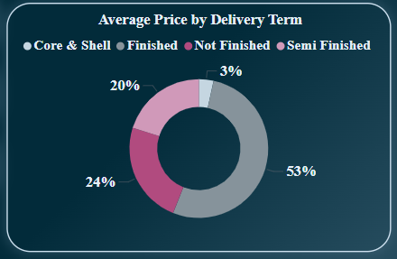
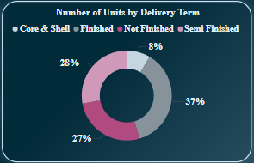
Key Insights of Average Price by Delivery Term
CONTENT TABLE
The chart shows the Number Of Units by Delivery Term for four categories of property finishing:
Finished: 37%
Not Finished: 27%
Semi Finished: 28%
Core & Shell: 8%
The largest portion is "Finished" at 37%, while "Core & Shell" has the smallest shares at 8% each.

Slide 29
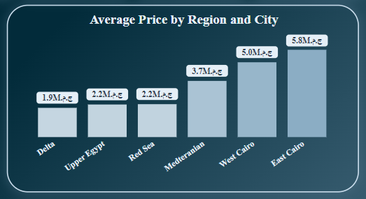
Key Insights of Average Price by Region and City
CONTENT TABLE
The image presents a bar chart titled "Average Price by Region and City," showing the average prices in millions of Egyptian pounds (M EGP) for different regions in Egypt. Here is a summary of the data:
Delta: 1.9M EGP
Upper Egypt: 2.2M EGP
Red Sea: 2.2M EGP
Mediterranean: 3.7M EGP
West Cairo: 5.0M EGP
East Cairo: 5.8M EGP
East Cairo has the highest average
price, while Delta has the lowest.

Slide 30
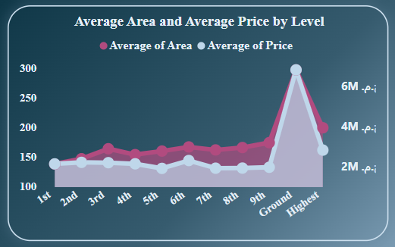
Key Insights of Average Area and Average Price by Level
CONTENT TABLE
The chart compares Average Area and Average Price by building level:
For levels 1st to 9th, both area and price remain relatively stable.
On the Highest level, there is a sharp spike in both average area and price, reaching up to 300-meter square in area and 5M EGP in price.
The Ground level shows no significant change in either measure.
The highest level has the largest area and price, while other levels remain consistent.

Slide 31
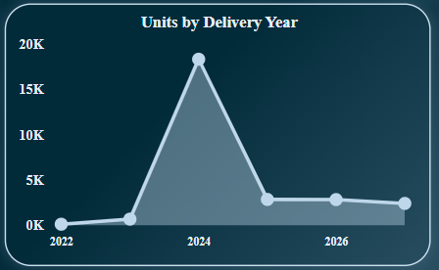
Key Insights of Number of Units by Delivery Year
CONTENT TABLE
The chart shows units by delivery year:
2022 and 2023 have low, stable unit deliveries.
A sharp peak occurs in 2024, reaching nearly 20K units.
Unit deliveries drop significantly in 2025 and 2026, stabilizing at around 5K.
2024 is the standout year with the most deliveries.

Slide 32
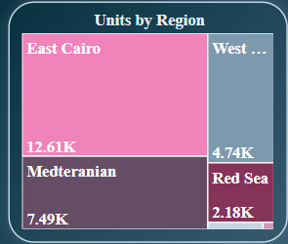
Key Insights of Number of Units by Delivery Year
CONTENT TABLE
The chart compares units by region:
East Cairo leads with the highest number of units, totaling 12.61K.
The Mediterranean region follows with 7.49K units.
West Cairo has 4.74K units, placing it third.
The Red Sea region has the fewer, with 2.18K units.
East Cairo stands out as the region with the most units, while the Delta has the least.

Slide 33
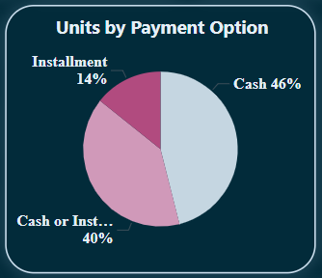
Key Insights of Units by Payment Option
CONTENT TABLE
The pie chart titled "Units by Payment Option" breaks down real estate units by payment method:
- 46% are paid in Cash.
- 40% offer a Cash or Installment option.
- 14% are paid through Installments.
In summary, cash payments make up the largest share, followed closely by a mix of cash or installment options, with installment-only payments being the smallest segment.

Slide 34
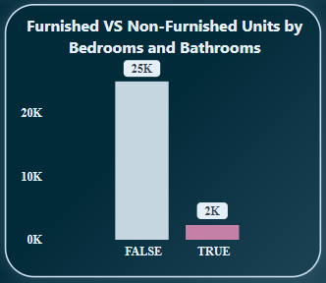
Key Insights of Furnished VS Non-Furnished Offers
CONTENT TABLE
The chart shows the number of Furnished vs Non-Furnished Offers:
- Non-Furnished (False): 25K offers
- Furnished (True): 2K offers
Non-furnished offers are much more common. You can also view a detailed breakdown of bedrooms and bathrooms through drill-down analysis.

Slide 35

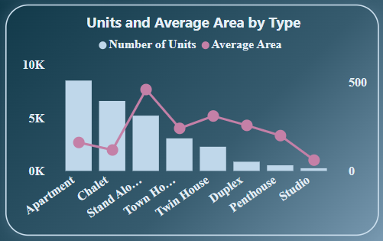
Key Insights of Average Area by Type
CONTENT TABLE
The bar and line chart "Offers and Average Area by Type" compares property types:
- Apartments and Chalets lead in offers, while Duplexes, Penthouses, and Standalone houses have fewer.
- Studios, Town Houses, and Twin Houses have moderate offer counts.
In terms of area:
- Standalone houses and Penthouses have the largest space, while Chalets, Duplexes, and Apartments offer smaller areas.
Summary: Apartments and Chalets dominate in availability, whereas Standalone houses and Penthouses provide the most space.

Slide 36
CONCLUSION
CONTENT TABLE
Egypt
REAL ESTATE

Slide 37
CONTENT TABLE
The Egyptian real estate market, particularly in East Cairo, offers a wide range of properties, with a noticeable concentration of high-end, luxury units in select compounds like Katameya Heights. Cash payments dominate the market, while non-furnished units are more prevalent. Delivery trends suggest a peak in 2024, followed by a sharp decline. Apartments and Chalets are the most offered, but Standalone houses and Penthouses offer more spacious living areas. Finished units are priced highest, and higher floors tend to have larger, more expensive properties.

Slide 38
THANKS
CONTENT TABLE
Does anyone have any questions?

